Slide 1
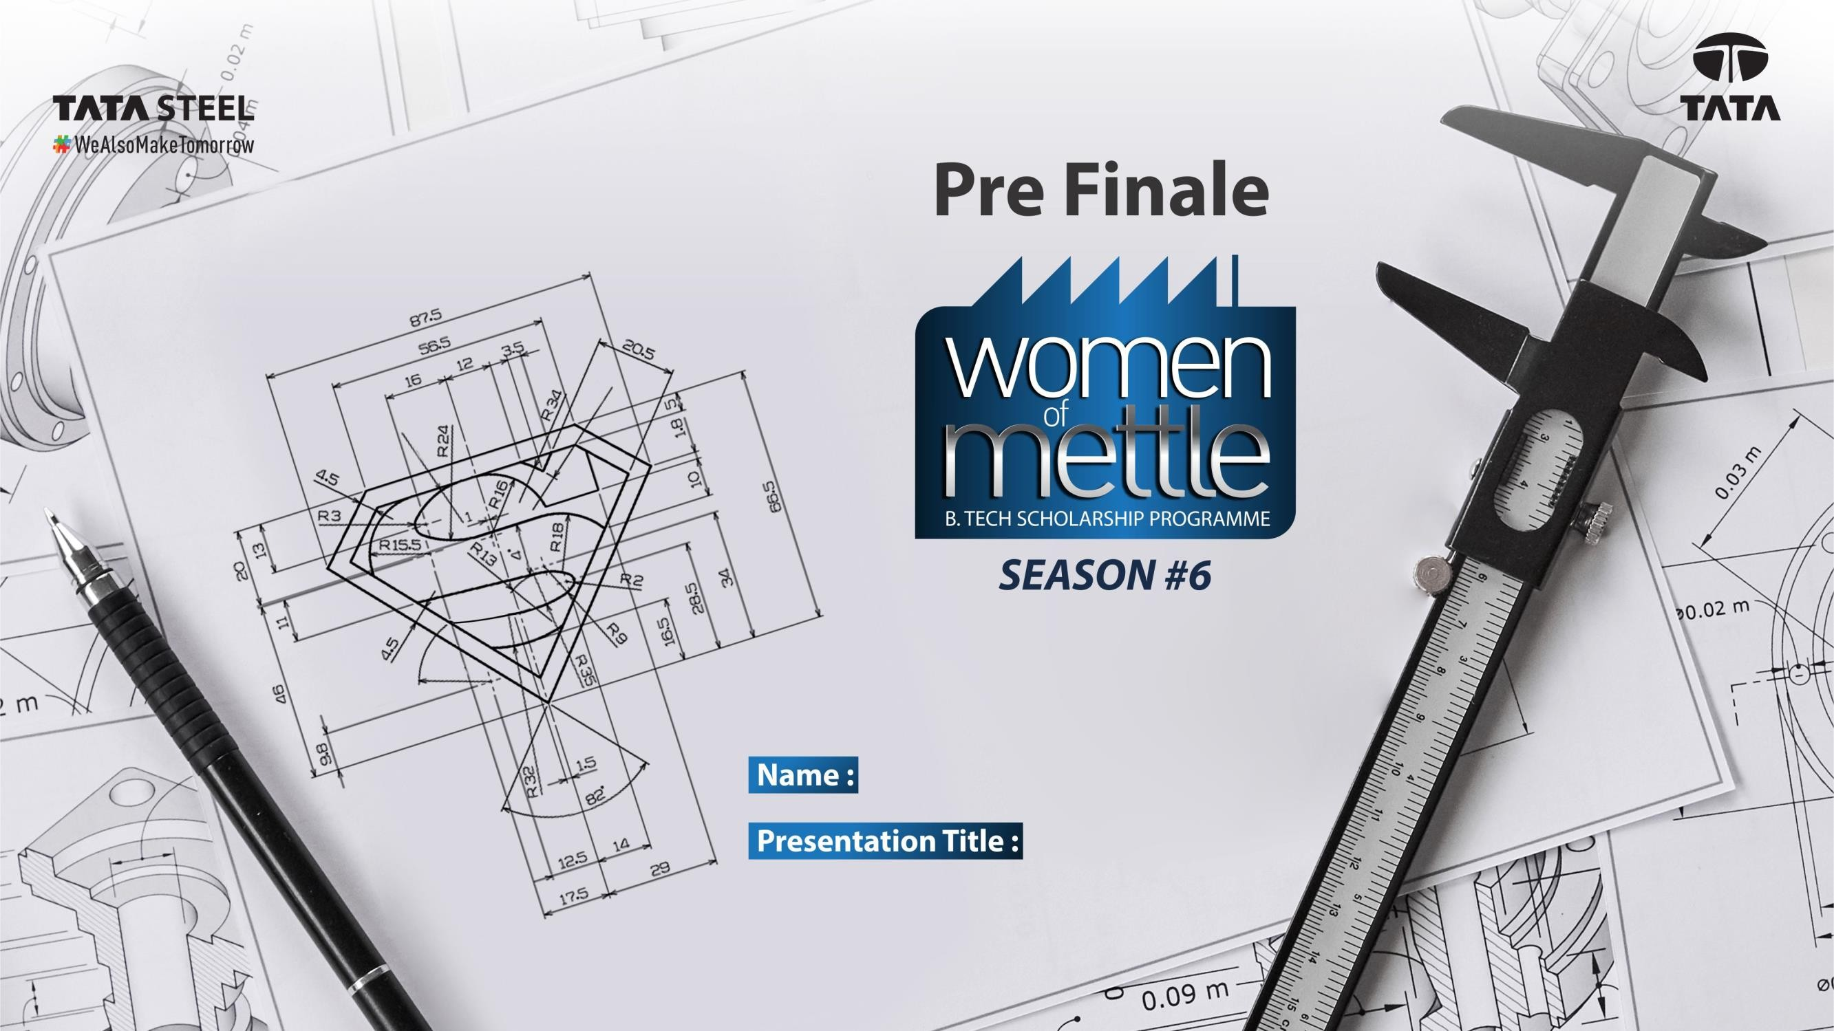

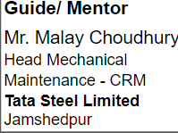
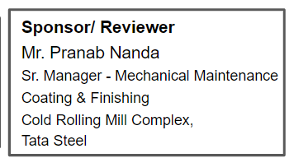
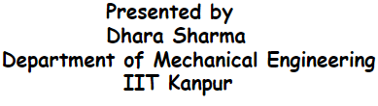
Dhara Sharma
Reliability Improvement at CGL2 SPM

Slide 2

What is Continuous Galvanizing Line?
Continuous Galvanizing is a process in which the surface of a continuous steel strip is coated on both sides with a thin layer of zinc. The coating, which is applied by passing the sheet or strip through a zinc bath at high temperatures, improves the corrosion resistance of the final product.
The continuous galvanizing process involves the following steps:
The sheet surface is cleaned to remove oils, surface oxides and iron fines using rotating brushes and caustic soap.
The steel is preheated to a low temperature for further cleaning and reducing of time required to anneal.
The sheet is put in the reducing zone for annealing.
Once annealed, it is cooled to a temperature roughly matching that of the molten zinc. This is done to avoid compromising the coating adherence, which can arise if the sheet's temperature is too high.
After the annealing and cooling, the sheet is passed through molten zinc at a speed of 650fpm. This speed allows the sheet to be in the bath for between two and four seconds.
The sheet drags molten zinc on its surface as it exits the bath. Gas knives are used to remove the excess zinc and only leave the desired thickness of the coating.
Once the coated sheet exits the bath, it is cooled and the zinc solidifies on the surface. A strong metallurgical bond is formed by diffusion to form the alloy layer.

Slide 3
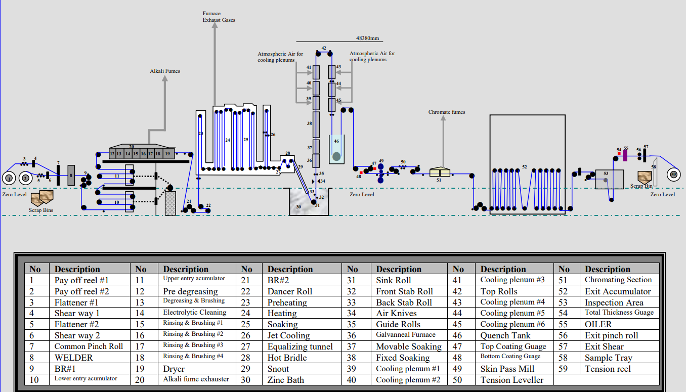
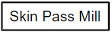
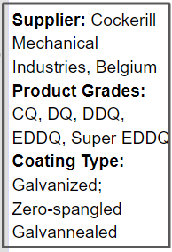
Lay-out of Continuous Galvanized Line#2
Focus of Project
Continuous galvanizing line is used to apply a coating of zinc onto the surface of steel strip to improve corrosion resistance.

Slide 4
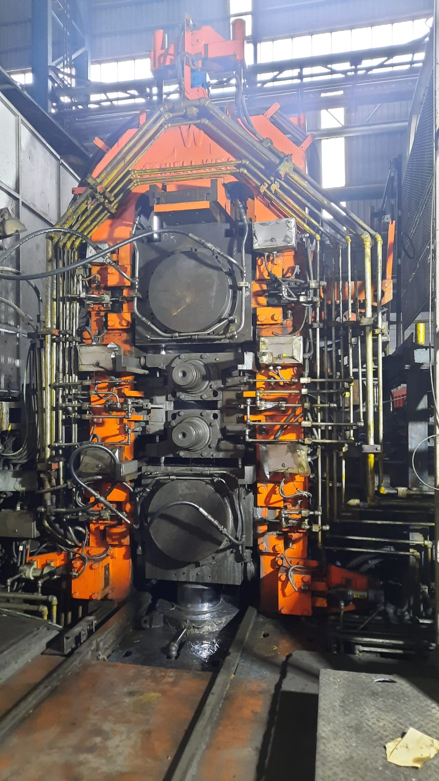
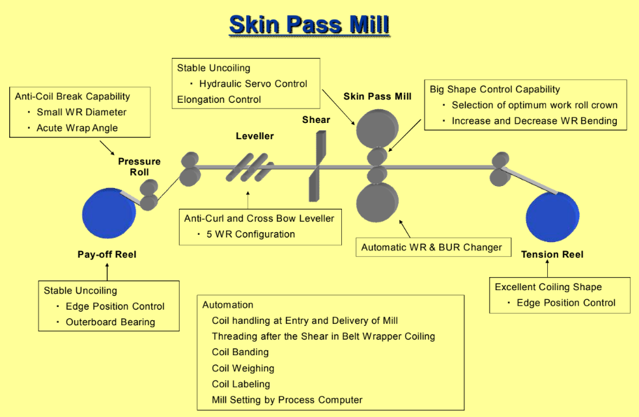
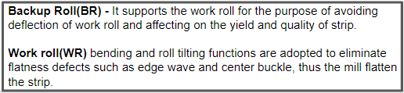
We have a 4-high wet type skin passing mill whose main purpose is to give desired surface texture/roughness to the strip. It suppresses the yield point elongation.
Configuration of Skin Pass Mill
Top Back Up Roll (BR)
Work Roll (WR)
Bottom Back Up Roll (BR)
Roll force hydraulic cylinder

Slide 5
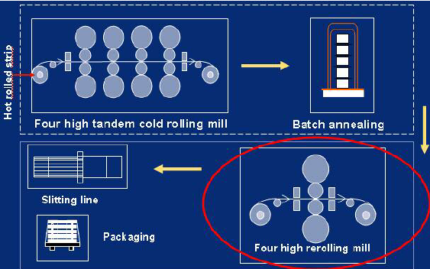
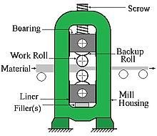
Functions of SPM
Adding a definite degree of roughness to strip for
paintability property
Surface defect elimination
Enhancement of physical properties

Slide 6
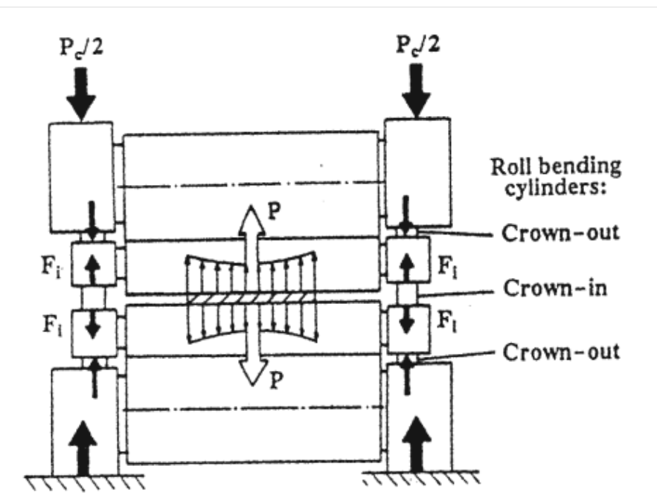
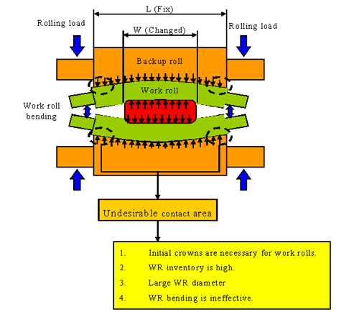
Work Roll Bending Forces
Pinching - During rolling of metal sheets defects may occur, such as local waviness, surface ruptures, sometimes strip breaks. It occurs due to uneven pressure applied on the sheet. This may happen because of uneven cylinder position at work side and drive side or any issue with cylinder pressure or work roll position.

Slide 7
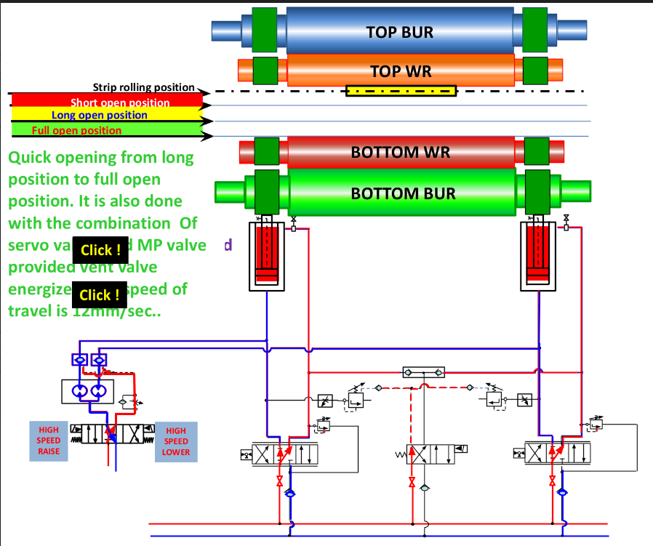
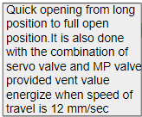
Detail of Skin Pass Mill Hydraulic System
The bottom backup roll is moved vertically by roll force cylinders controlled by a servo valve and electronics which acts as a closed loop position servo when the work rolls do not contact the strip, and as a pressure servo when the work rolls do not contact the strip .
There are mainly 4 positions of travel for the roll force cylinder:-
Rolling position
Short position - It is 5mm below the strip rolling point
Long position - It is waiting position, 35mm below the strip rolling point
Full open position
The roll force cylinder must stop 8mm before the full open position until the
lower drive stops.

Slide 8
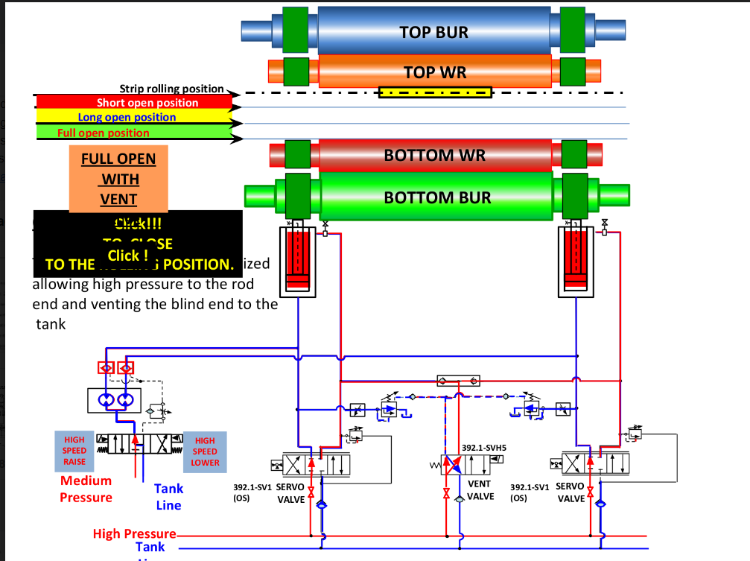

Operational Details of SPM
The mill consists of 9 distinct states of operation.
These states can be individually operated in manual mode or combined together in auto mode.
The states are:
1. Reduce force to a nominal value - Mill at rolling position, drives ON
2. Reduce force to zero - Mill at rolling position, drives ON
3.Short position open - Mill open at 5mm gap between work rolls, drive ON, crown in ON
4. Long position open - Mill open with maximum gap that still allows drive ON, crown in ON
5. Full open
6. Long position close
7. Short position close
8. Close on strip
9. Calibration : Mill drives are stopped.
10.Full open with went valve

Slide 9
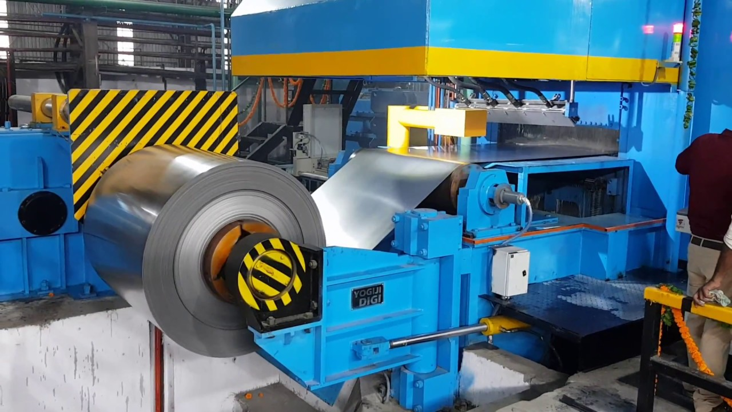
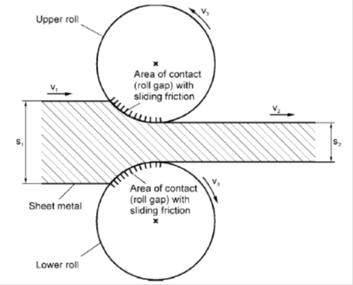
What is Cold Rolling?
Cold rolling is a metal forming process where a stock or sheet metal is compressed and squeezed between rollers at temperatures below the recrystallization level. The magnitude of compression determines the hardness and thickness of the finished material. Various conditions like quarter hard, half-hard, full hard, and skin-rolled determine the value proposition of the end product. In full hard, half-hard, and quarter hard, the metal stock is reduced by up to 50%. In skin rolling, the metal stock is reduced by 0.5 to 1% to achieve to a smooth surface.

Slide 10
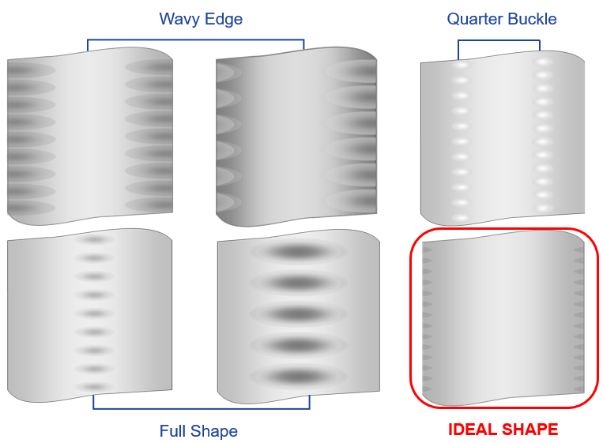
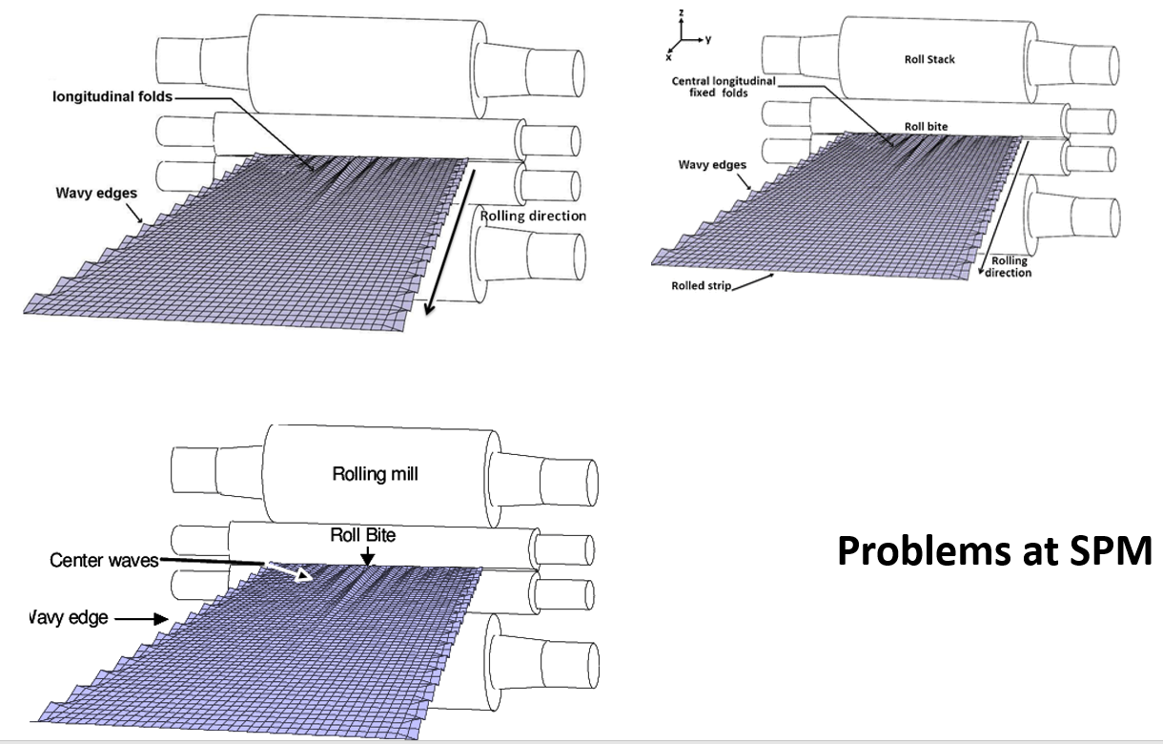
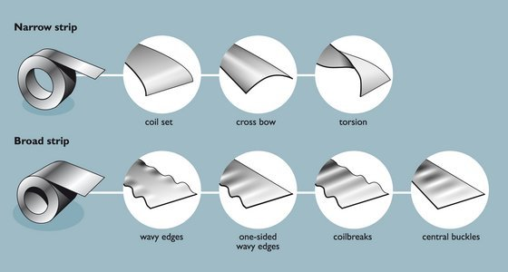
Cold Rolled Strip Defects
At the end of the production process—cold rolling, annealing, strip temper rolling, and surface coating application—there is a risk of stability loss of the coil and the formation of shape defects, such as folded structure; oval (elliptical) distortion due to sagging under their own mass; axial displacement of the turns in the coil (telescopic distortion); mutual slip of the turns and consequent surface damage of the strip; and uncoiling of the coils over the thickness.

Slide 11
Understanding Current Issues at SPM
Zeroed Tilting values are abnormal after Mill GAP Zeroing. The values comes in the range of +0.1 to +0.8 mm. Even For that we need to insert Shim above TOP BackUp Roll Chock before Zeroing. Currently we are inserting Shims between 0.4 mm to 1.2 mm. This is the condition for last 3 to 4 years. Before that we used get Zeroed Tilting values in the range of +/- 0.05 mm.
Differential Force is always hunting. Operator adjusts the tilt values to reduce differential force to normal +/- 50 KN range. But it does not holds. Even within same coils, he needs to adjust again.
After The Weld Pass with reduce force, again the differential force changes even without any change in Incoming Material or any change in SPM Settings.
Another peculiar problem is that with differential force Negative, i.e. theoretically more resultant force in Drive Side of strip, but Pinching and waviness comes in Operator Side.
Then Operator has to operate with very high Negative Differential force. Sometimes we need to operate with differential force of more than -100 KN.
Bending Values Changes very slowly if set point is changed from Positive to negative and vice versa. At Times Bending Hunting is also observed causing chatter Mark On strip.
HGC servo valves and controllers also malfunctions frequently
Both HGC cylinder tuning has not happened in a very long time-step response to be checked

Slide 12
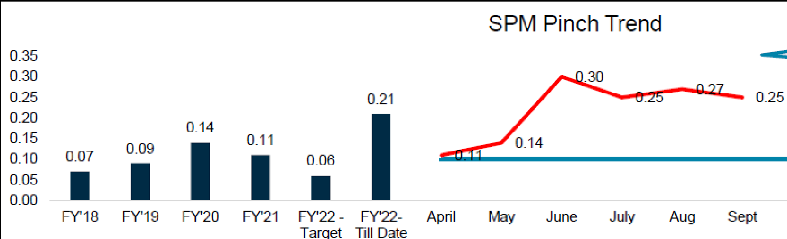
Defect % ( of total defect) due to SPM Pinching

Slide 13
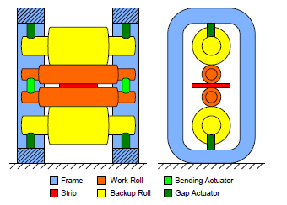
Current philosophy of Skin Pass Mill (Operations Practice)
Observation :
1. The backup roll needs to be changed after a processing of 12000 tons of steel which implies three shutdowns in a month and each backup roll change activity requires 6 hrs.
In current scenario we cut the strip, do the roll change and then we do gap zeroing after which we have to rethread the strip and do brazing. This entire process involves multiple time power isolation and desolation. All this happens because of strip cutting at Skin Pass Mill.
2. As per SPM OEM Expert ( M/s Danieli , Italy) , gap zeroing needs to be done even after work roll change which happens after every 1500 T of steel processing . In current scenario , this is not possible .
Recommendation
If we can explore the possibility of gap zeroing with spacer, we can reduce time by 3 hrs in every shutdown. This is mentioned in OEM Manual , though it is not established .
We can do gap zeroing after each backup roll change also.

Slide 14
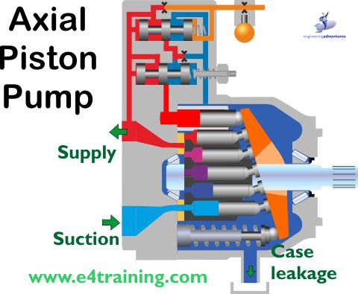
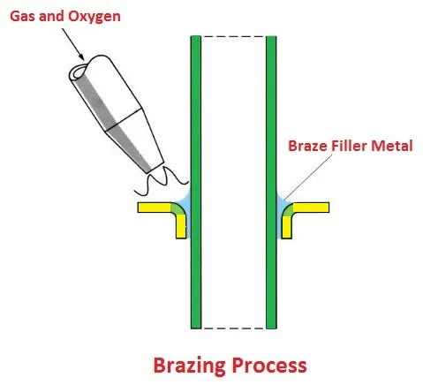
Current Philosophy of maintenance practice at Skin Pass Mill
Mill:
Gap zeroing after backup roll change
All temper fluid nozzle cleaning.
SAP-PM based preventive measure and inspection.
Mill Hydraulics :-
Oil reservoir level, temperature inspection
All hydraulic pumps pressure checking
Hydraulic oil cleanliness(NAS class/ISO) measurement. (Every 2 month)
Accumulator N2(nitrogen) pre change pressure checking (every 6 month) (Gap)
All hydraulic valves thermography analysis for any internal leakage. (Newly established practice)
Accumulator thermography during service to know the working.
All hydraulic actuator inspection/replacement.
All hydraulic pump internal leakage (case drain) measurement for knowing the pump’s service life. (Newly established practice)

Slide 15
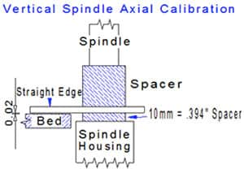
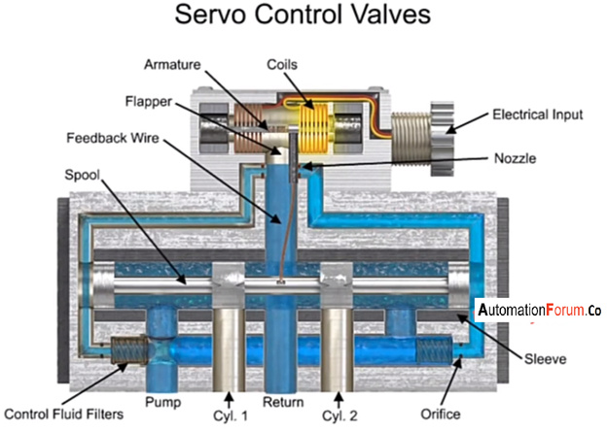
Recommendation
1. Mill calibration with spacer to save strength duration because in SPM manual it has been mentioned that two types of calibration / mill zeroing can be possible but we failed to do calibration with spacer. Hence at every SD we need to cut / braze the strip
Responsibility : Operation , Maintenance
2. As per OEM (M/S Danieli) after each work roll change, mill must undergo a calibration but in current practice it is not possible as we cannot stop mill in every 3000 ton of production (3 days) which is a work roll change schedule.
Responsibility: Operation , Maintenance
3. In SPM, servo valves are the vital installation in the hydraulic circuit. In current practice we cannot check/assess the health of the servo valves. But as per SPM we must measure different servo valve characteristics indefinite period. This can be developed.
Responsibility: Mechanical Maintenance

Slide 16
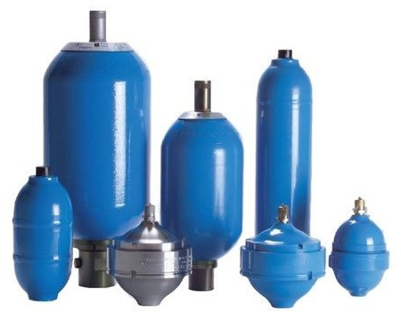
Recommendation
4. Current practice we inspect the accumulator pre-charge nitrogen pressure. For this activity we need to put gauge and measure the pressure. During this activity some pressure drops during fitting connection/disconnection. If online pressure measurement can be done then productivity will improve. Responsibility : Mechanical Maintenance
5. Pass line checking w.r.t. drawing - This will ensure proper gap zeroing position .
Responsibility : Mechanical maintenance
6. Calibration of sensors ( Pressure transmitter , position sensor )
Responsibility : Electrical maintenance
Other Recommendations
Accumulator
By applying the camber on rolls in the opposite direction, the surface in contact with the sheet becomes flat after a deflection.
The use of hydraulic jacks works well in instances where wavy edges occur. These jacks control the elastic deformation of rolls as per the requirements. Also, the use of small diameter rolls works efficiently.
Edge effects occur due to uneven heating, uneven rolling or excess quenching so this should be checked properly and we can use trimming operation to remove edge cracks, Also, stretch and roller levelling under tension might work against edge cracks. Using edge rolls might help in achieving uniform rolls without any cracks. (Beyond Scope)
THANK YOU

